Slide 1
Understanding Your Patient Population and Patterns of Utilization
Modupe Idowu, MD
Professor
Director
UT Physicians Adult Sickle Cell Center
McGovern Medical School, Houston, Texas

Slide 2
Introduction
A patient population is a collection of individuals living with certain illnesses and conditions
Demographic and geographic features help define patient populations
In order to offer the right care at the right time and for the right price, health care providers must analyze patient outcomes based on patient population as they define it
Patient demographic data refers to all non-clinical data about a patient, including name, date of birth, address, phone number, zip code, sex, and race
Notes:
Healthcare systems can slice and dice their patient populations in a multitude of ways in order to analyze their performance. For example, a national hospital might compare various patient health attributes based on location, age, gender, or what medications patients are taking.

Slide 3
Introduction
Analyses across payers revealed that prior high health care use and behavioral health diagnoses are predictive of high ED use across populations levels of analysis
Behavioral health diagnoses were predictive of high ED use among Medicare, VA, and hospital/health system populations
Among multipayer and population-based studies, having Medicare and Medicaid insurance coverage was predictive of high health care use

Slide 4
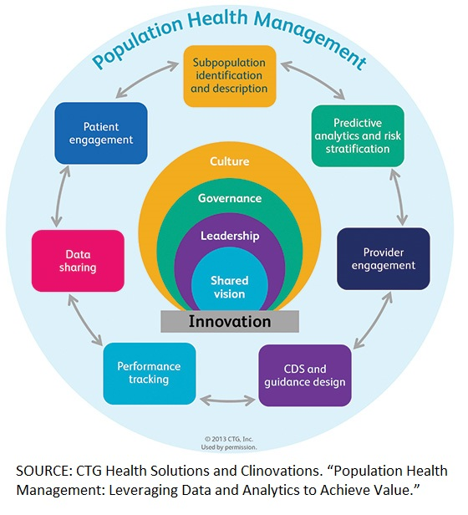
Population health management (PHM) lowers costs by refocusing health care on not just the sick, but also the well
Some of the first things that must be understood when launching a PHM program is what a population of healthy people looks like, how clinical risk is defined, how financial risk is measured, and what will be the metrics used to analyze how sick patients with chronic disease do and do not get sicker
PHM programs track and trend inpatient, ambulatory, and emergency department patients
Notes:
The goal of PHM is to keep a patient population as healthy as possible and reduce the need for expensive interventions like tests, emergency department visits, hospitalizations, and procedures. While most healthcare providers see the critical importance of PHM, they do not have the information technology, the required understanding of PHIM, or the data management skills and resources that are required to successfully utilize population health management.
PHM makes use of patient data registries and data banks to create a portrait of a certain population and analyze trends to find solutions to problematic behaviors and connect care gaps that may leave certain segments chronically underserved. Using population health data to its fullest extent and achieving complete data integration will “redesign the way providers approach and deliver care

Slide 5
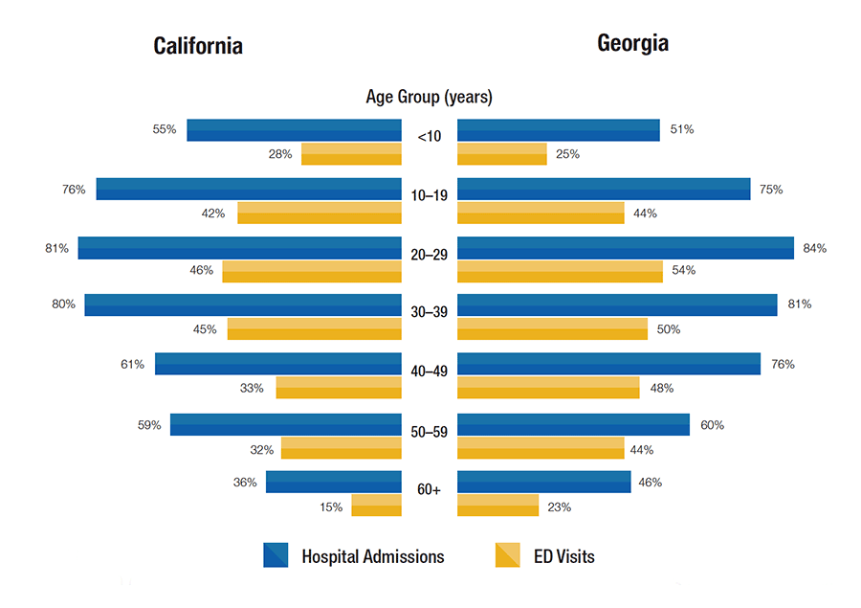
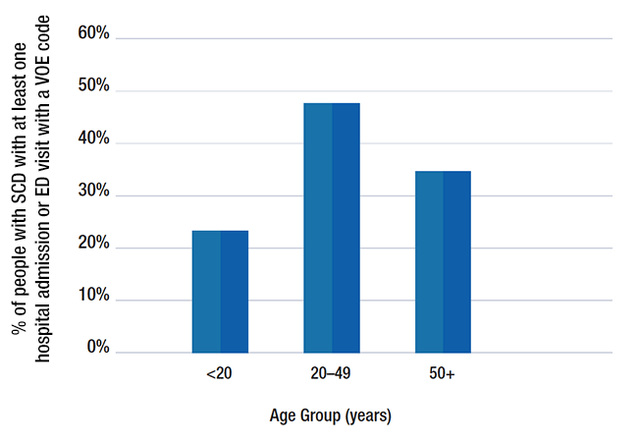
Healthcare Utilization for Vaso-occlusive Episodes by People With Sickle Cell Disease in California and Georgia
Centers for Disease Control and Prevention California and Georgia 2015 VOE data
Notes:
More than 4 in 10 (41%) ED visits and more than 7 in 10 (73%) hospital admissions for people with SCD in California had a VOE diagnosis code.
More than 4 in 10 (41%) ED visits and more than 7 in 10 (73%) hospital admissions for people with SCD in California had a VOE diagnosis code.
CDC’s Sickle Cell Data Collection (SCDC)
More than 4 in 10 (41%) ED visits and more than 7 in 10 (73%) hospital admissions for people with SCD in California had a VOE diagnosis code.
Nearly 1 in 2 (48%) ED visits and 3 in 4 (75%) hospital admissions for people with SCD in Georgia had a VOE diagnosis code.

Slide 6
Importance of Gaining Understanding of Your Patient Population and Utilization Patterns
Analyze and use data to develop quality metrics
Develop measurable and attainable goals
Provide ideas regarding organizations to approach for funding assistance eg, Managed Care Organizations
Financial and business planning
Discover program priorities and engage stakeholders
Improved performance and better coordination of care for chronically ill patients
Notes:
Certain MCOs have majority of the SCD pts in your area, you can approach them for funding after developing a great plan on how your intervention will significantly decrease acute care (ED/hosp) utilization.

Slide 7
Use the Data to Guide Program Development
Illustrative examples:
If data demonstrate: | Develop this:
Sub-optimal transition | Transition pathway
Long treatment waiting times in the ED | Fast-track pain management algorithm
Long waits in ED for a “bed” | Patient-controlled analgesia (PCA) in ED
Long ALOS | Individualized pain treatment plans PCA utilization, inspiratory spirometry, and VTE prophylaxis Dedicated social worker Inpatient provider/nursing education Enhanced outpatient care team Hematology consultation
Pregnancy | Multi-disciplinary pathway of care
Transfusion needs | Antigen matching Allo-ab identification standardization Apheresis program (includes transfusion and vascular medicine)

Slide 8
Use the Data to Guide Business Planning
Data you need:
  Visits, visit types (inpatient, outpatient, ED), and lengths of stay
  Costs (not charges) and payments associated with each visit
  Staff costs (salary and fringe)
  Costs associated with infrastructure development
  Quality of care indicator data
Identify where needed quality of care improvements align with potential financial improvements

Slide 9
Overview of Cost of Care Among Amerigroup Medicaid SCD Patients in 2018
In 2018, there were 68 patients with sickle cell disease (SCD) under Amerigroup Medicaid
Average expenses during 2018 among these 68 patients were $36,286 (SD = $42,125).
The total expenses for these 68 patients were approximately $2.5 million
Twelve patients (17.6%) had total expenses greater than $75,000
SCD patients incurred significantly higher economic burden than patients with no chronic disease

Slide 10
Distribution of Total Expenditure Among Amerigroup Medicaid Patients with No Chronic Disease

Slide 11
Heath Care Utilization Among Amerigroup SCD Patients 2018

Slide 12
Health Care Utilization Among Amerigroup UTP SCD Patients During 2018-2019

Slide 13
QI Project: Problem
Texas Children’s Hospital Sickle Cell Program lacks a formal transition process, including the absence of verbal communication with adult sickle cell disease (SCD) providers at time of transfer of care
Disparate mortality rates in young adults with SCD correspond with poor transition outcomes, including increased emergency health care utilization, discontinuation of disease-modifying therapies, and lack of knowledgeable adult providers

Slide 14
QI Project: Description and Rationale
To develop a sustainable framework of information-sharing between pediatric and adult health care systems for transition-aged patients with SCD
A warm handoff is a strategy to improve successful transition between two health care facilities caring for patients with chronic illnesses, with the primary goal of reducing interruptions in care for young adults after transfer

Slide 15
QI Project: Description and Rationale
Current Process

Slide 16
QI Project: Description and Rationale
Current process relies on an empowered, organized, and motivated patient to navigate obstacles that may arise with access to care
Of 11 adult SCD providers, only 1 offers comprehensive care
  - UT Physicians (UTP) Comprehensive Sickle Cell Center
  - UTP transitioned to EPIC EHR system in May 2021

Slide 17
Initial Activities
 | Aim 1 | Aim 2a | Aim 2b | Aim 2c
Plan | Plan patient & caregiver survey distribution; Plan & schedule 4 focus groups | Plan EHR transfer summary note smartphrases | Identify key features of warm handoff process | Create education slides and learning session for providers/staff at TCH & UTP
Do | Distribute surveys; Host 4 focus groups | Create and disseminate EHR note smartphrases | Design process map of warm handoff care conference | Present education at SCD team meetings and host learning session
Study | Score surveys; Assess group feedback | Review TCH & UTP provider/staff feedback | Review feedback from patient, caregiver, provider/staff | Review post-session feedback
Act | Rank lowest scoring survey topics; Organize & report focus group themes | Revise/improve EHR note smartphrases | Revise/improve warm handoff process map | Revise/improve EHR note smartphrases and warm handoff process map
Lean Tools |  |  | Spaghetti diagrams; Value-stream maps; Operational manual

Slide 18
Expected Outcomes and Benefits
Patients would benefit from coordinated assistance with transfer
Providers would benefit from establishing a means for formal communication between pediatric and adult healthcare systems
Transfer process enhanced by tracking post-transfer outcomes

Slide 19
Project Aim
To create a sustainable warm handoff strategy between our pediatric SCD site (TCH) and Houston’s only comprehensive adult SCD site (UTP) by optimizing EHR information-sharing and extending the period of establishing transition readiness beyond the transfer date

Slide 20
Key Stakeholders
Whose input and support will this project require?
  Patients
  Caregivers
  TCH SCD providers/staff
  UTP SCD providers/staff
How will you engage the key stakeholders?
  Surveys
  Focus groups (virtual/in-person)
  Education

Slide 21
Progress Report
Aim 1: Transition Readiness Surveys
Table 1. Mean scores for transition readiness assessments *SD: Standard Deviation
Table 2. Correlations between youth and caregiver scores *p-value < 0.05
 | Patient (N=11) Mean (SD*) | Caregiver (N=11) Mean (SD) | p
Transition Importance | 8.30 (0.6) | 7.50 (1.0) | 0.59
Transition Confidence | 5.82 (0.8) | 6.50 (0.9) | 0.38
Health & Health Care | 28.55 (2.7) | 28.60 (2.6) | 0.69
Medicines | 5.64 (0.2) | 5.20 (0.2) | 0.10
 | Correlation Coefficients | p
Transition Importance | -0.09 | 0.80
Transition Confidence | 0.63 | 0.04*
Health & Health Care | 0.37 | 0.27
Medicines | 0.44 | 0.17

Slide 22
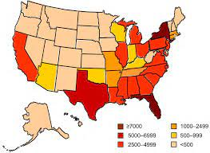
Patient Population
Texas State has the 3rd largest SCD population with 5000 to 7000 affected people
UTP Adult Sickle Cell Center
  Adult 18 and older
  >1000 adult pts
  58% of patients are Medicare /Medicaid.
CDC Data & Statistics on Sickle Cell Disease

Slide 23
Referral Sources
Transition program: Baylor College of Medicine/Texas Children Hospital, Houston (Warm transition program) Ligums Grant
UTP Pediatrics
Houston and surrounding areas within a 200 mile radius
Community hematologists
Patients discharged from pediatric practices who have been lost to follow-up for some time
Remote Texas towns > 2-hour drive from Houston

Slide 24
Initial Challenges
Lack of funding
Individuals with SCD were receiving care at the Cancer Center without specialized staff or designated resources
<100 adult SCD patients were seen prior to August 2015
Minimal administrative support
Few SCD clinical trials

Slide 25

Story of UTP Sickle Cell Center
Fall 2014: Grant received from MCO to establish a medical home to provide optimal coordination of care for SCD patients; later sustained by funds from NAIP/DSRIP
August 2015: Started UTP Sickle Cell Center with <100 adult patients
Now we have >1000 adult patients
Partnerships with sickle cell advocacy groups
Attend SCD adult/teenage camps and community events
We have strong upper administration support
UT participates in multiple SCD clinical trials phase 1 to 3 in the CRU

Slide 26
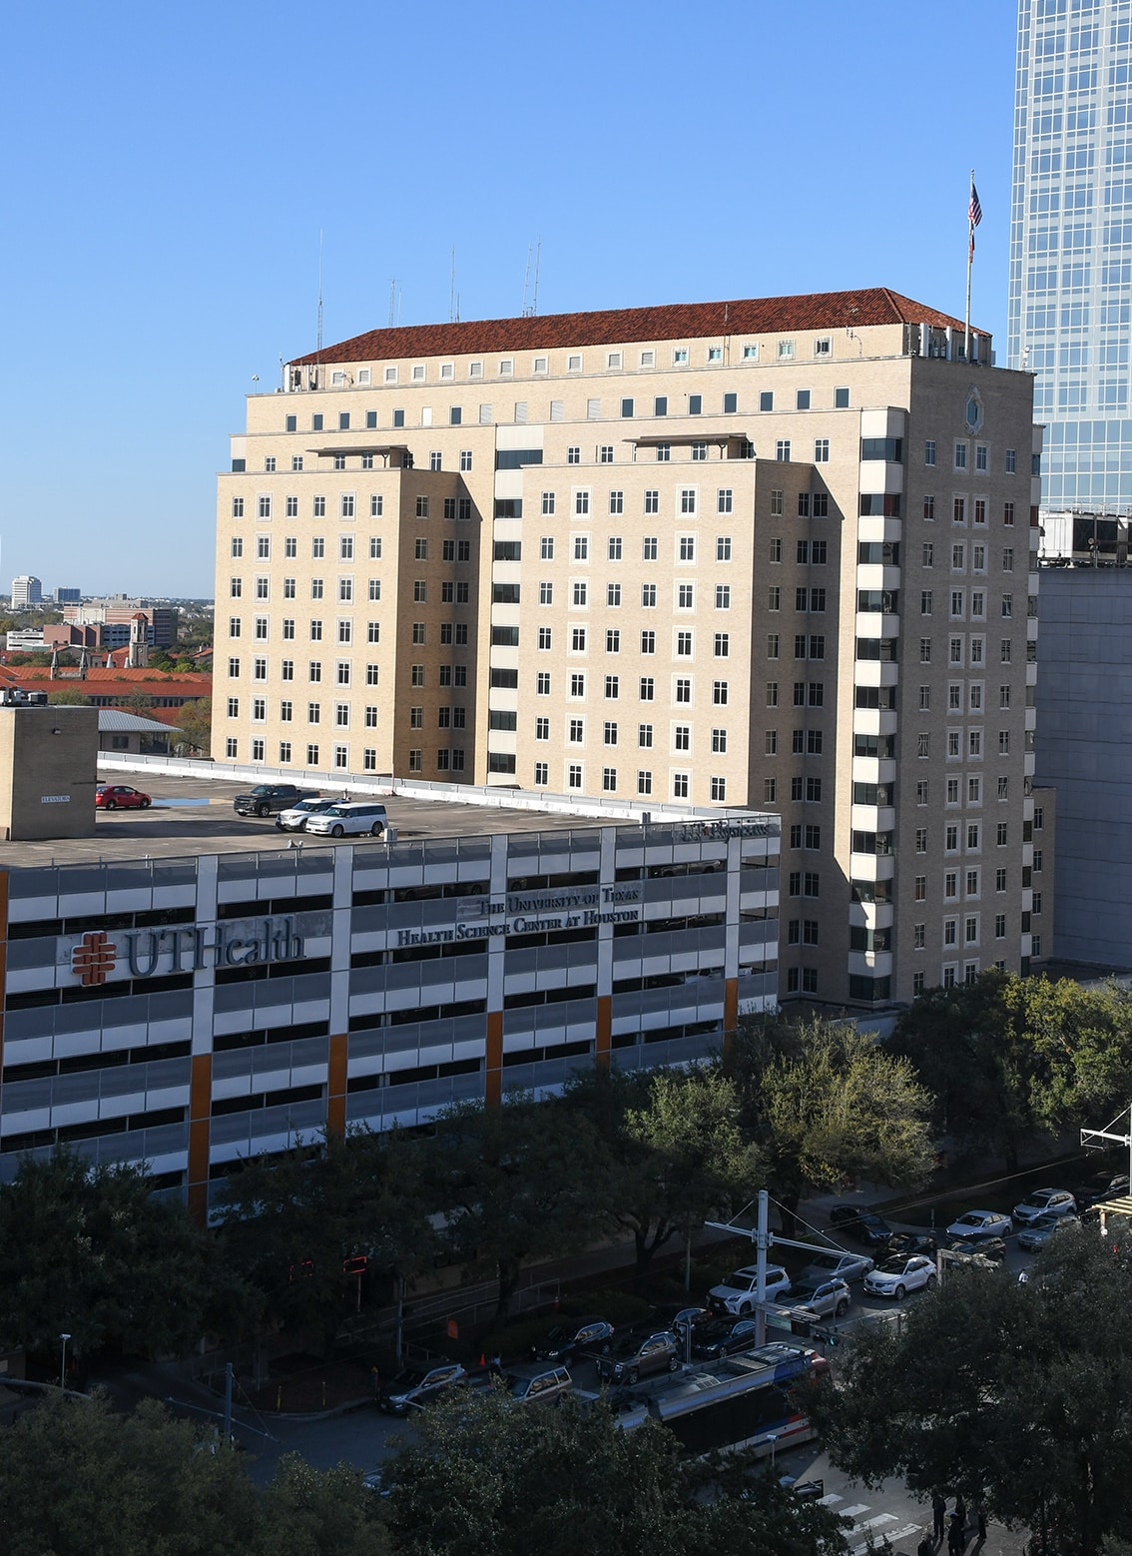
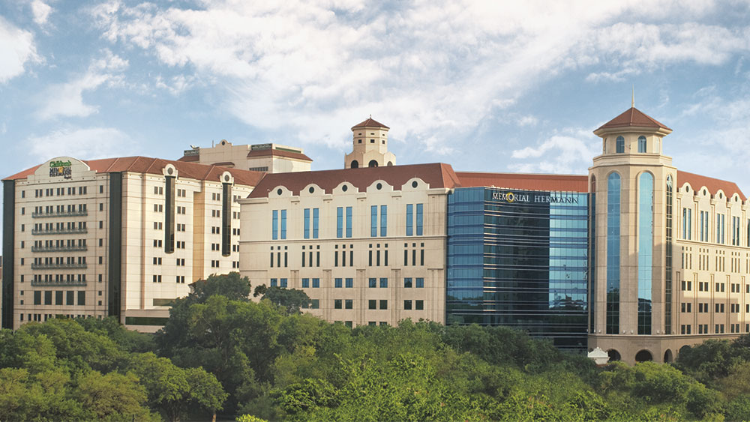
UT Physicians Comprehensive Sickle Cell Center and Memorial Hermann Texas Medical Center Houston

Slide 27
UTP Sickle Cell Center
Only dedicated Sickle Cell Center in Houston, Texas
Warm transition program with Texas Children Hospital (largest children hospital in Houston)
We reviewed records of patients seen at our infusion room and we have been able to prevent about 85% to 90% of ED visits for the treated patients
We advocate for our patients and educate the community on SCD management/accommodation (hospitals, schools, employers)
Improved academic and occupational achievement for our patients
National Alliance of Sickle Cell Centers—one of the first 10 adult centers in the U.S.

Slide 28
Patient Engagement and
Community Health Partnerships
Patient engagement is not a one-size-fits-all endeavor, instead, organizations should consider the different needs and preferences of their populations to target their patient engagement initiatives
Community health partnerships will help break down the walls between patients and health care institutions
Organizations can begin to build trust, increase visibility, and build a positive reputation

Slide 29
Quality Improvement Projects and
Team Meetings
Sickle cell taskforce: a multidisciplinary team of hematologist, hospitalist director, ED director, pharmacist, and nursing administrator that reviews, updates, and distributes the SCD pathway/electronic order set; the team also coordinates care of SCD patients who are high-need, high-cost (HNHC)
Reduction of ED wait time for SCD patients (IM resident, hematology fellow, medical students, hematologist)
Multidisciplinary monthly meeting with MCO and Amerigroup

Slide 30
Interventions to Overcome Barriers
Diligence in area of practice—it is possible that you will find a State grant that will fund your center
Gain your supervisor’s support by working hard on research, publications, and clinical activities—improve institution visibility while gaining some bargaining power
Good interpersonal and communication skills with setting up multidisciplinary teams in the inpatient and outpatient settings to address your concerns while networking with other team members that can help connect you
Then present the patient population data, utilization data, and budget, and ask for support

Slide 31
Sustainability
Grant sources—different organizations, payers eg, MCO
Active research program with multiple clinical trials
Consider hiring advanced practice practitioner (APP) to assist with clinical work
Care team—experienced CHW, SW, CM
Specialized nurses
Primary care provider

Slide 32
UT Physicians Comprehensive Sickle Cell Center
Adult patients seen
Internal Medicine/Primary care – routine care
Adult Hematology
Pain specialists
Adult Renal, Endocrinology, neurology, ortho
Adult Pulmonology
Adult Cardiology
Maternal-fetal specialist/OB/Gyn
Psychiatry – Adult, Adolescent
Psychotherapist/Counselor – Adult, Adolescent
Social worker, case manager
Genetic counselor
Specialized nurses and medical assistants
Community health worker
Infusion suites – walk-in
Echo and EKG on site
PFT
Lab on site
Dental screening at UT dental school
Ophthalmology
Imaging facility in the building
Specialty Pharmacies – home delivery
Experienced CRU (30+ years) for inpatient and outpatient studies
Apheresis center
Community Advisory Board
ASH-CTN

Slide 33
Continuity of Care
Dedicated sickle cell NP to follow and coordinate SCD patients' care while inpatient
Heme consult service follow
Standardized opioid regimen but customized to each pt’s needs
Heme service ensures pain meds Rxs are filled at discharge
Electronic SCD passport/plan updated by NP at discharge
Post-hosp follow-up in 1 week
Apheresis appts made if needed
COMPREHENSIVE SICKLE CELL CENTER MEDICAL INFORMATION CARD NAME: John Doe DOB: 1/1/1998 SICKLE CELL TYPE: Hb SS BASELINE HGB: 9-10 RBC ALLOANTIBODIES: negative COMPLICATIONS: Moyamoya syndrome, CVA with R hemiparesis, iron overload, seizure SPECIAL PROCEDURE: RBC exchange every 8 wks MEDICATIONS: folic acid 1 mg daily | OUTPATIENT PAIN REGIMEN Tylenol #4 every 6hrs as needed INPATIENT PAIN REGIMEN Morphine PCA basal 2 mg/hr; demand 2 mg q10 min, Norco 10/325mg q6h, Toradol 15 mg IV q6h. PLEASE NOTIFY UT HEMATOLOGY IF PATIENT IN HOSPITAL IDOWU, MODUPE MD Office: 713-486-5660/fax: 713-486-5661 1200 Binz Street, Ste. 850, Houston, TX 77004 Card issue date: 05/14/2019

Slide 34
Lessons Learned
Gain the attention of your institution and top administrators by increasing academic productivity through QI projects, publications, and participation in clinical trials
Use current data to understand your patient population
Nurture relationships with internal and external stakeholders to develop a strong program
Let the statistics drive your program’s priorities and financial planning
Use quality improvement projects as opportunities to develop your program

